Slide 1
The Service Pattern
Organising Application Behaviour – Moving from data access to business operations

Slide 2
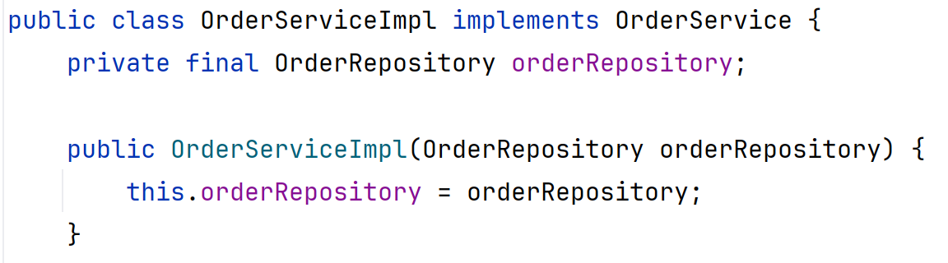
What is a Service?
  Service: A component that defines what operations an application can do
    Provides the business logic & enforces the business rules
    Intermediary between repository & presentation layers
    Coordinates the work across various areas in the system
Application/CLI/GUI:
“Show me order 105”
OrderService:
Provides order-related operations, including business validation, rules & recovery
Repository layer
OrderRepository
DAO Layer
Orders - OrderDetails - Products - Customers
Database
JDBC -> MySQL
Notes:
Application asks for operation it wants to be carried out, but doesn’t need to know or care what parts of the system are involved.
Service coordinates the actions across different repositories and decides what happens if something goes wrong

Slide 3
Why Do We Need Services?
Without a Repository, the front end may need to: | With a Repository, the front end:
Call on several repositories to gather all required information for an action Must know how data is structured & managed | Asks for a specific action to be carried out, e.g.: Placing an order Cancelling an order
Apply business rules | Receives a result from the requested service
Coordinate multi-step actions, e.g. adding an order with all of its components
Decide what happens where something fails
  The service pattern is a coordinating layer
    It doesn’t replace repositories, it expands on them
    Wraps and combines repositories within the business/domain

Slide 4
The Benefits of Services
  Clearer separation of concerns
    Services manage areas of application using repositories
    Repositories gather and act on related data using DAOs
    DAOs manage specific sections of data using connection to database
  Promotes code reuse
    If the business logic is not embedded in the UI, it can be reused in many contexts
  Improves scalability
    By decoupling the business logic from the UI, we can more easily refactor to scale for more users at a later date
  Simpler presentation code
    UI has no involvement or knowledge of how business logic works
  Focused tests for business behaviour

Slide 5
What Does a Service Do?
  Expose meaningful operations through a clear API
    Each service method represents a specific use-case for the application
  These operations:
    Coordinate the steps needed to complete an operation
    Apply or invoke business rules and validations
    Call repositories to retrieve and persist data
    Define the outcome when a step cannot be completed
  Remember: Always keep presentation and persistence details
  out of the service API

Slide 6
Service vs Repository: Different Roles, Different Responsibilities
Service — Application operation
Repository — data access for application
use case
Example:
• placeOrder()
Check business rules
Coordinate the repositories involved
Focus: coordinate repositories to gather info/trigger actions.
Example:
• getOrder(orderNumber)
Coordinates relevant DAOs
Assembles the useful results
Focus: coordinate data access (DAOs) that carry out database work
Different layers have different responsibilities. Each layer uses the one below to do its job!

Slide 7
Use-Case:
Place an Order For a Basket of Items
1 Service
Validate request and business rules
2 ProductRepository
Check product availability and prices
3 OrderRepository
Create order and order lines
The CLI asks:
“Order this basket for customer #42.”
4 Service
Coordinate outcome and return confirmation

Slide 8
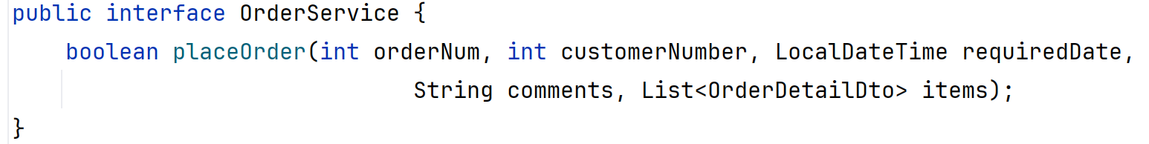
Design the Service API First!
  Name methods after user actions/use-cases
    As with repositories, method names should indicate what you’re trying to do, not what tables are involved
  Accept IDs, simple parameters or complex objects
    Let the parameters suit the action being requested
  Return USEFUL results, including custom DTOs where necessary/useful
    Don’t tie yourself to entities – you can build objects that suit this particular request
  Do not expose SQL-related classes
    This includes Connection, PreparedStatement and ResultSet!
Remember: An interface is a contract saying what the service can do

Slide 9
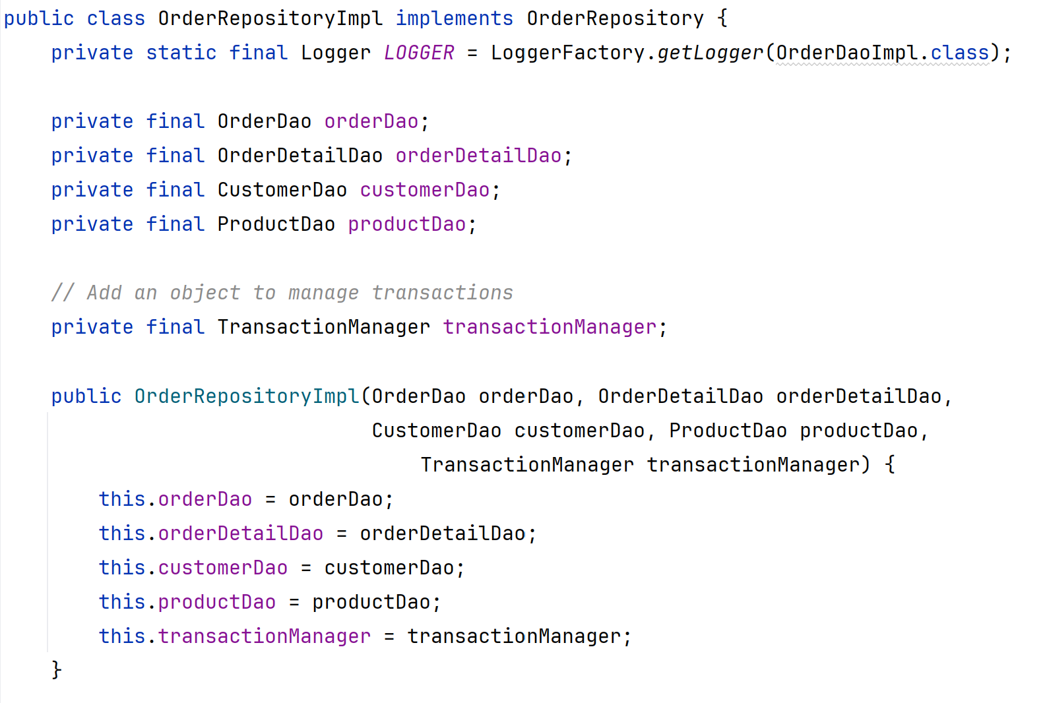
Service Implementation Using Repositories Via Their Interfaces
Constructor injection
Dependencies are supplied from outside.
No SQL here
The service requests data and actions from repositories – no direct DB access
Reminder:
Interfaces keep implementations replaceable and testable!
Full code: week08_services/services/OrderServiceImpl.java

Slide 10
Business Rules & Multi-Step Operations
  A service method coordinates a complete operation - start to end.
  The operation is usually comprised of multiple steps, such as:
    Confirming permission for action
    Validating request parameters
    Applying business logic validation (e.g. confirming minimum quantity before attempting to order)
    Coordinating calls to several repositories (e.g. confirming stock availability before placing an order)
    Deciding on final result and returning a clear indication of success/failure

Slide 11
Database Transactions:
Multi-step Actions on a Database
  Database transaction: A sequence of related SQL actions that make up an overall action
    Each SQL action is a sub-step in the overall transaction
  Example: Borrowing a book:
    Create the loan
    Reserve the book
  If one sub-step fails, the entire transaction should fail
    Roll back the previous sub-steps to reset the entire process
    Loan shouldn’t exist if there are no copies available to borrow

Slide 12
Transactions in Services:
Coordinating Actions Across Repository Calls
  Database actions happen at the DAO layer
    Only knows about the specific action it’s carrying out
  Services implement transactions through chaining multiple repository calls
    Has a global view of how the transaction is progressing
    Can tell if something has failed partway through
  However, services don’t have database access!
    Can’t undo database changes – they’re at the wrong level/layer

Slide 13
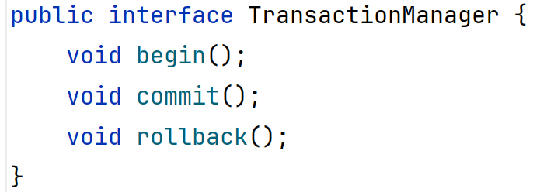
The Transaction Manager:
Coordinating Actions Across Repository Calls
  The Transaction Manager is a class dedicated to transaction management
    Uses Connector object to control current database connection
  Contains 3 methods:
    begin() – start the transaction
      Establishes connection & disables autocommit
    commit() – save transaction on success
    rollback() – reset transaction on failure
Added to service via dependency injection – see slide 9!

Slide 14
Common Mistakes to Avoid
Business workflow in the UI
Move the logic to a service method; have the UI call this method
SQL inside a service
All SQL and database mechanics belong in in the DAO layer only
Service that only renames/wraps repository methods
Either add more application logic to the layer, or reconsider if you really need the layer at all
One giant “ApplicationService” that handles everything
Split your services based on logical areas/use-cases

Slide 15
Testing: Confirming Your Boundaries Hold
DAO integration tests
Repository Tests
Service unit tests
Use a test database to verify SQL, constraints, row mapping and persistence behaviour.
Verify use-case combined results and handling of missing or invalid data.
Use mocked repository objects to verify business rules and call coordination. Confirm success and failure behaviours.
Something to ask yourself:
If one of your repository implementations changes but its interface stays stable,
should the service need to change?

Slide 16
Final Takeaways – Remember These!
  DAO: Database actions and row mapping
  Repository: Application-facing data access and DAO orchestration
  Service: Application-facing use-cases, business rules and workflows
  UI should only ever interact with the service layer directly
    Service is the middle-man between UI and Repository
    Repository is the middle-man between CLI and DAO
  Use constructor injection (form of dependency injection) to ensure dependencies are explicit and customisable
Remember this workflow:
CLI → Service → Repository →
DAO → JDBC → MySQL

